Slide 1
Waialua Community Association
Ilona Hemperly
2020 ANNUAL MEMBERSHIP MEETING
FEBRUARY 19, 2020
7:00 PM
HISTORIC HALEIWA GYM

Slide 2
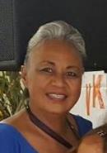
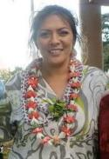
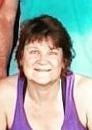
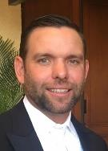
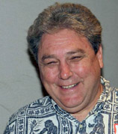
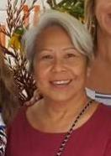
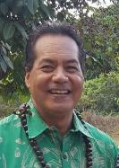
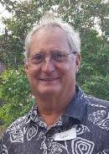
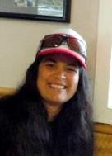
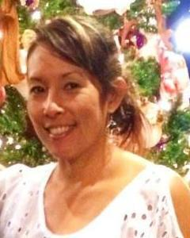
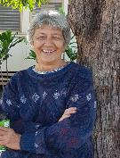
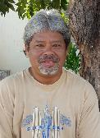
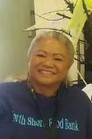
2019 Board of Trustees and Staff
President
Vice President
Secretary
Treasurer
Executive Board
Manu Anana Tammy Escorzon Bridget Bordeau Jason Lehmkuhl
Trustees
Charlyn Sales Keith Awai Jennifer Hernando Leif Andersen Ann Otteman Boyd Ready
Staff
Michele Rego Berni Paik-Apau Derrick Manners Valerie Oga

Slide 3
MEETING AGENDA February 19, 2020
Call to Order
Welcome and Pule | Nominations
Introduction of Board | Candidate Introductions
Approval of Agenda | Vote
Approval of Minutes | Dedication of Plaque
Treasurer’s Report | Adjournment
Committee Reports | Refreshments
WCA Honorees
2019 In Review

Slide 4
2019 NET OPERATING INCOME
NET OPERATING INCOME
Income | $ 116,165.87.00
Expense | $122,343.88.00
NET INCOME | -$ 6,177.70
December 31, 2019 WAIALUA COMMUNITY CREDIT UNION ACCOUNT
Account Beginning Balance 2020 | $ 68,784.47
2019 GRANT (GIA) FOR MAJOR CAPITAL IMPROVEMENTS WORK TO BEGIN 2020
Commercial Kitchen Modifications | $ 16,000.00
Gym Floor | $ 60,000.00

Slide 5
2019 OPERATING REVENUE

Slide 6
2019 EXPENDITURES

Slide 7
BALANCE SHEET End of Year December 31, 2019
ASSETS | Amount
Bank Accounts | $ 79,930.08
Other Current Assests | $ 0.00
Holding Account | $0.00
LIABILITIES
Payroll Liabilities | $ 2,513.53
Other current Liabilities | $ 3,943.88
EQUITY
Opening Balance Equity | $ 5,809.97
Retained Earnings | $ 76,353.93
Net Income | -$ 6,177.70
Total Equity | $ 75,986.20
TOTAL CURRENT LIABILITIES AND EQUITY | $ 79,930.08

Slide 8
2019 in Review
ACCOMPLISHMENTS AND CHALLENGES
ACCOMPLISHMENTS
BEGIN OFFICE RENOVATION
INSTALLED PARKING LOT SIGNS
VARIOUS REPAIRS IN GYM
INITIATED TOWING SERVICE
SLURRY SEALED AND STRIPED FRONT PARKING AREA
COMPLETED COTTAGE #2 RESTROOM
CHALLENGES
MAJOR REPAIRS
JALOUSIE WINDOWS
OTHER WINDOW REPAIRS
ROOF LEAKS OVER OFFICE AND ATHERTON
TOURIST AND OTHERS PARKING
PUBLIC USE OF RESTROOMS

Slide 9
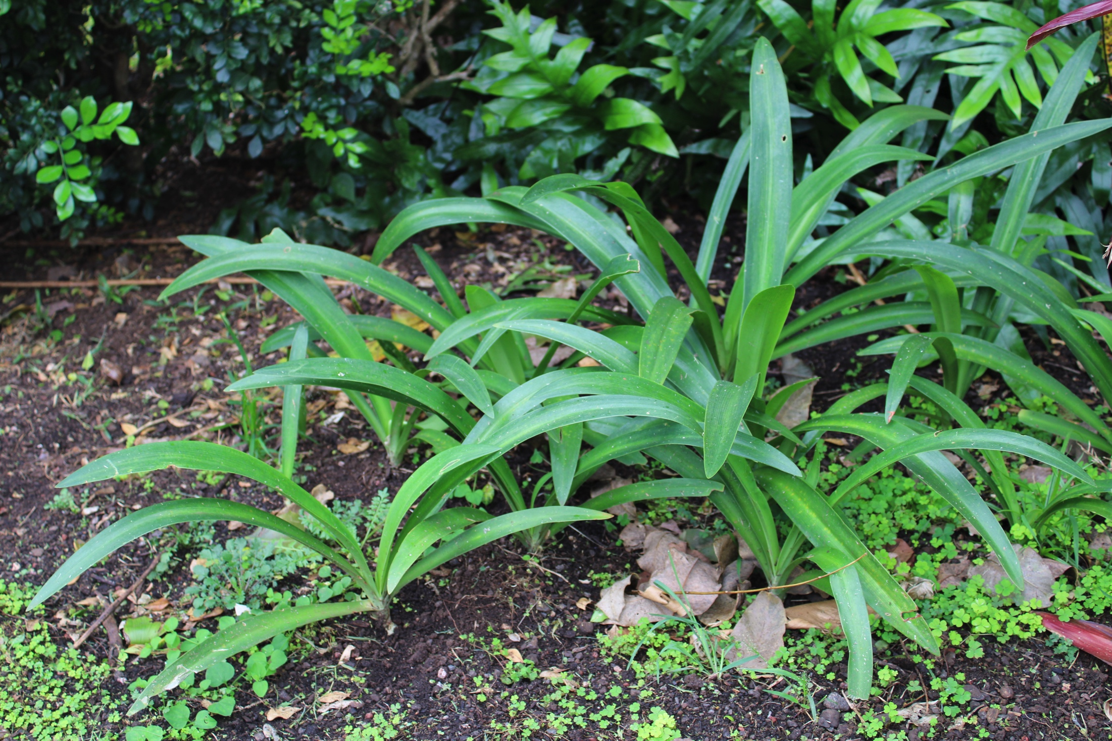
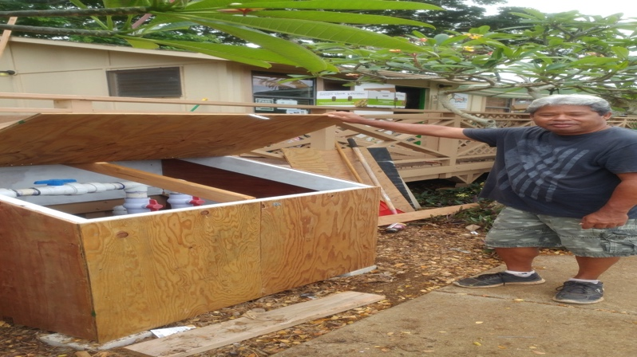
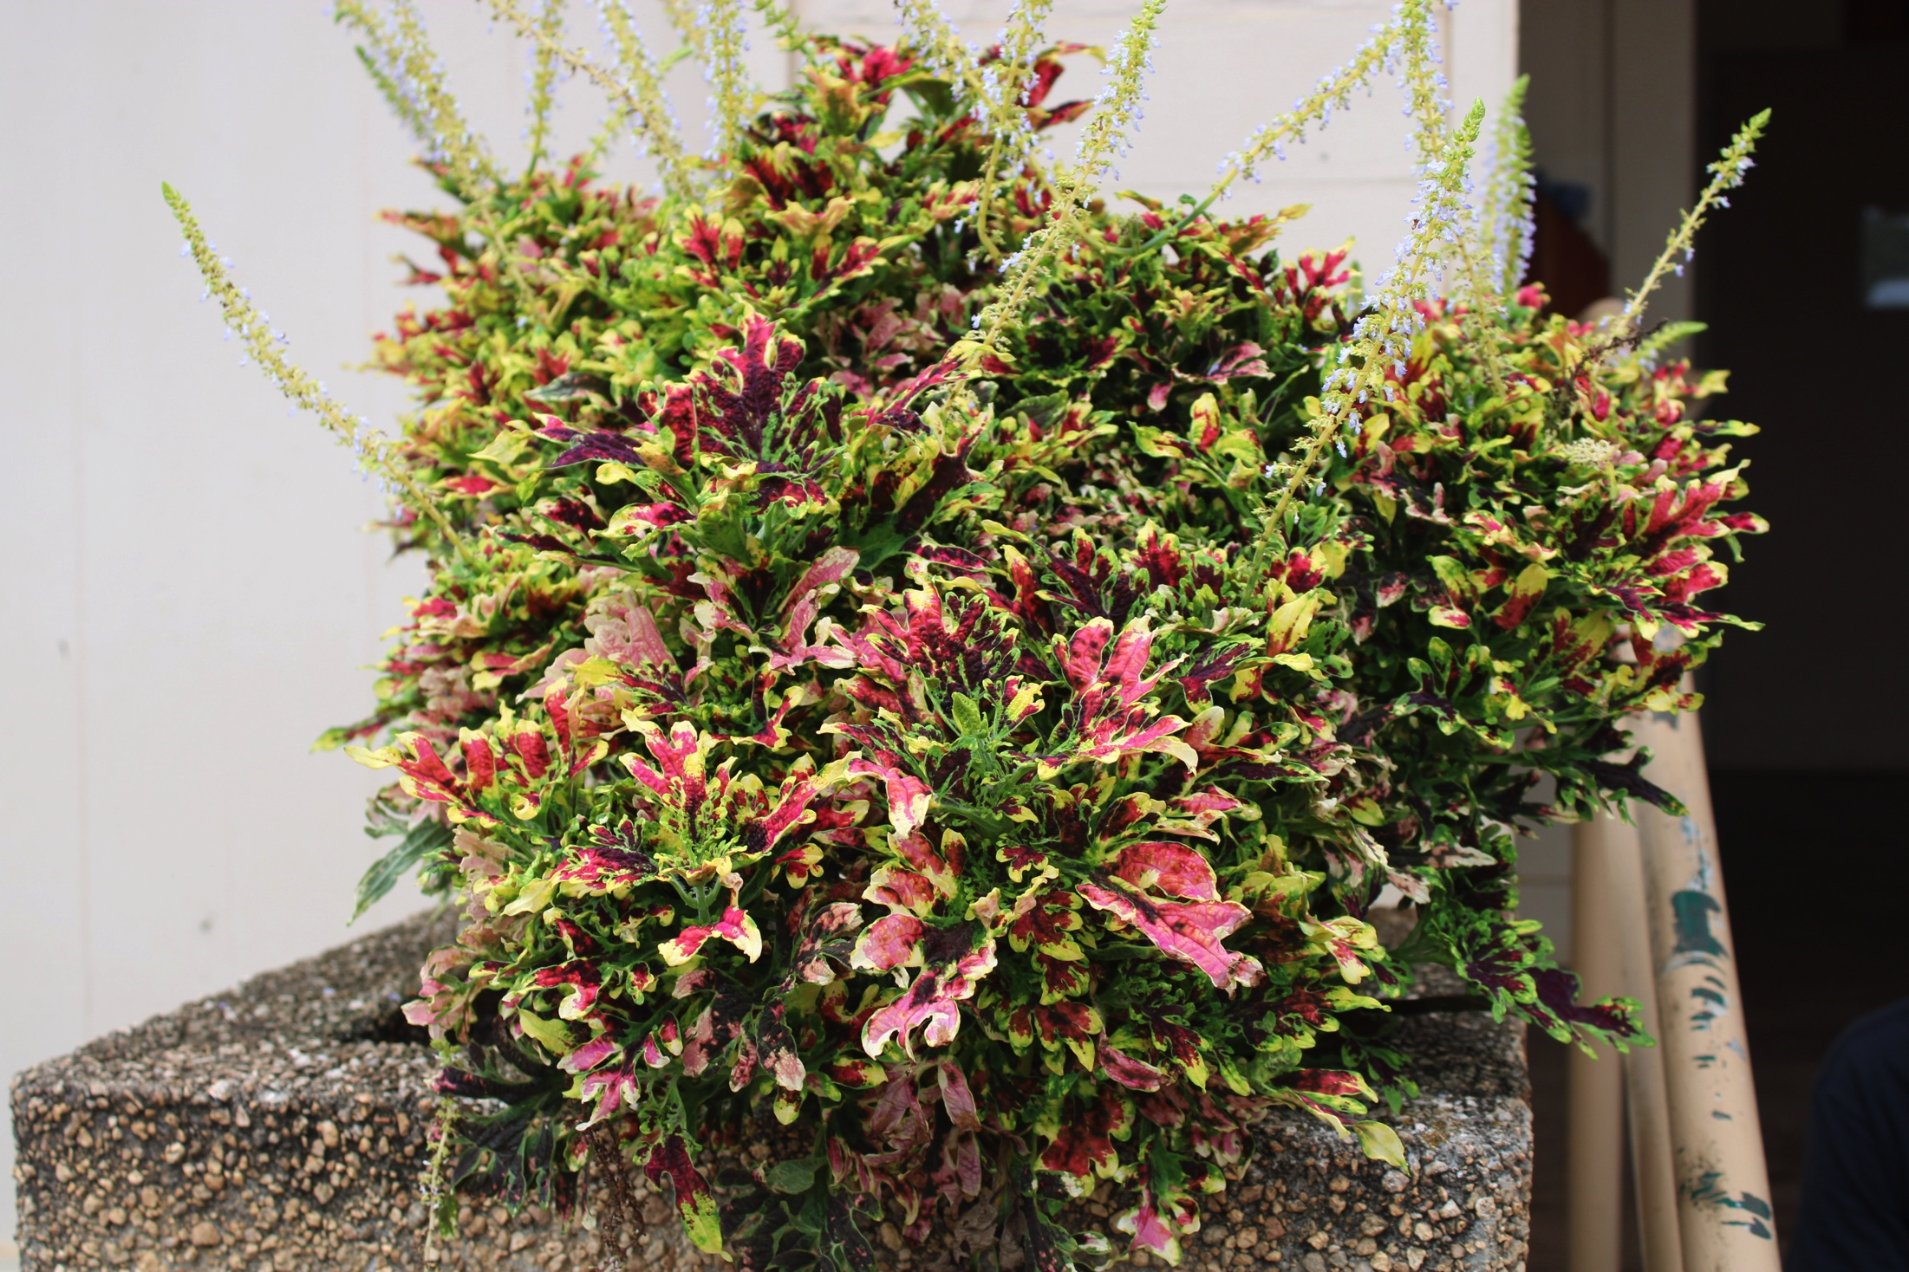
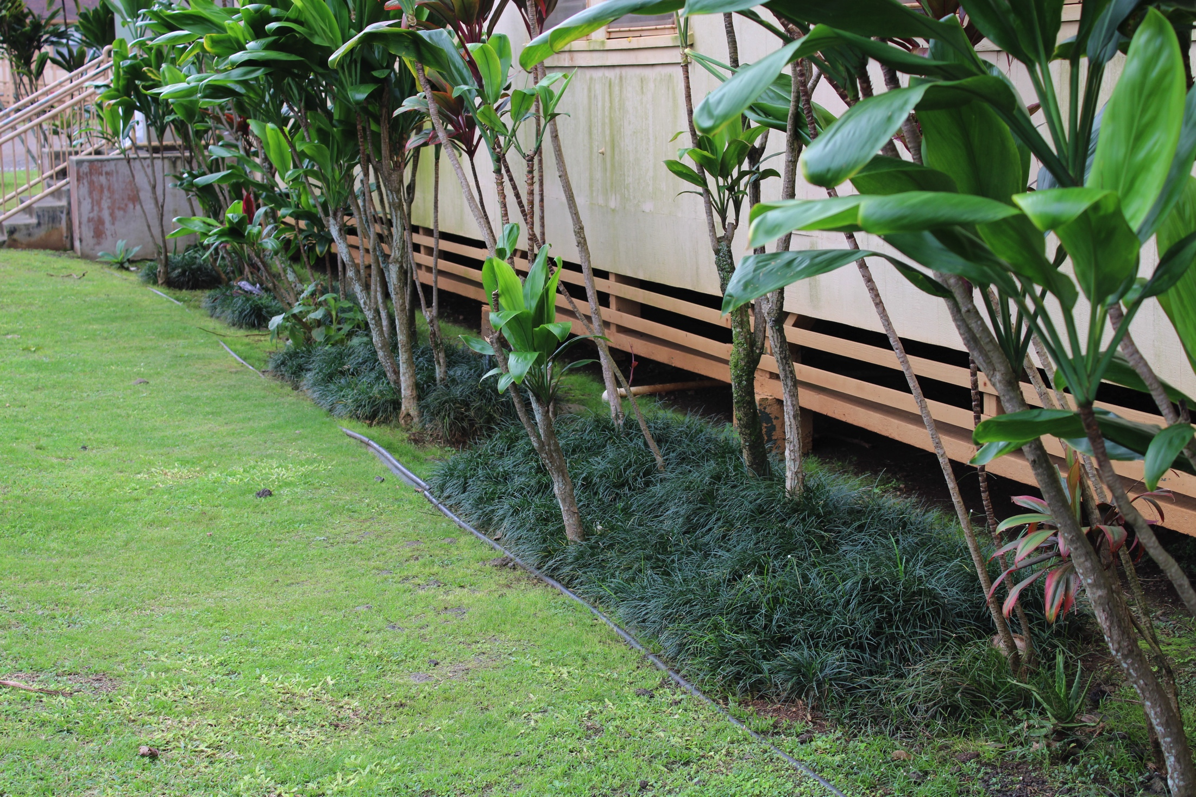
BUILDINGS AND GROUNDS COMMITTEE
Much was done over the year thanks to Derrick Manners, Leif Andersen, Bridget Bordeau and community volunteers.
Repaired Cottage deck and rails (ongoing)
Installed Parking Lot Signs
Completed Cottage #2 Restroom
Replaced worn toilet valves
Repaired stage lights
Removed stage rolling door
Built “Dog House” for pump
Beautifying grounds

Slide 10
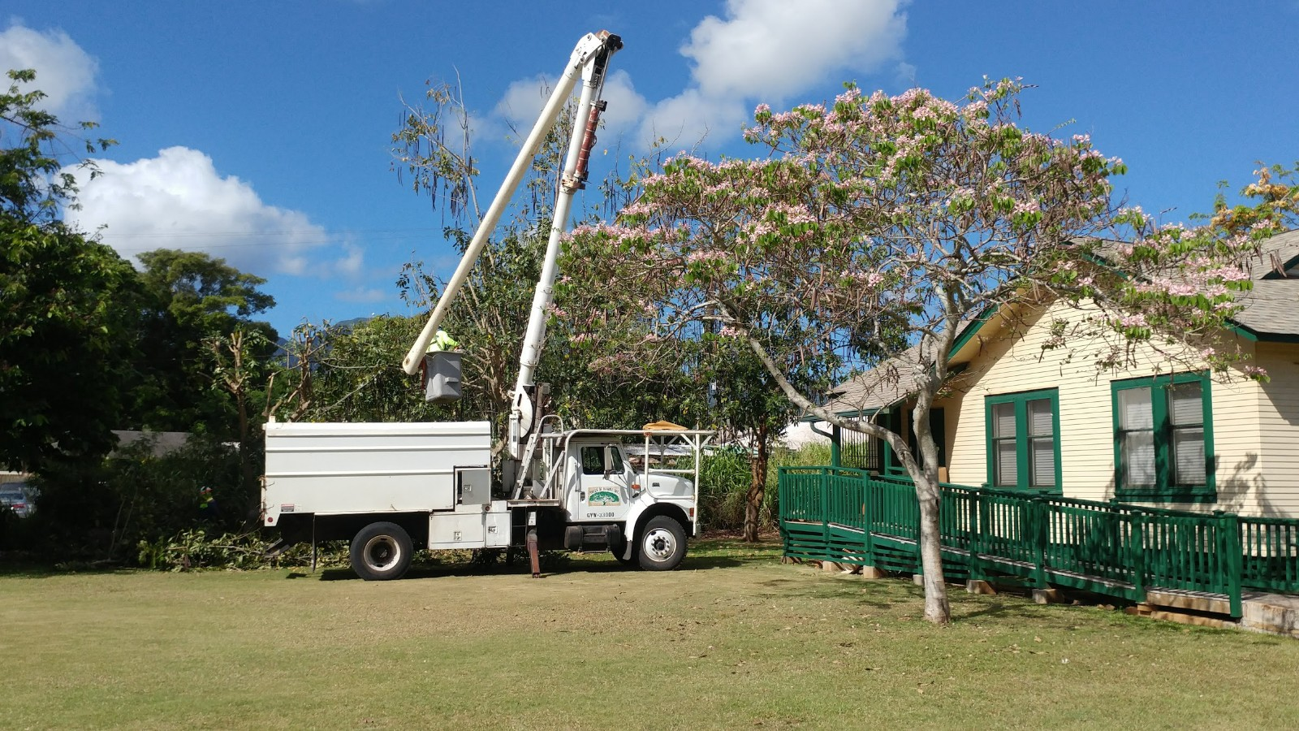
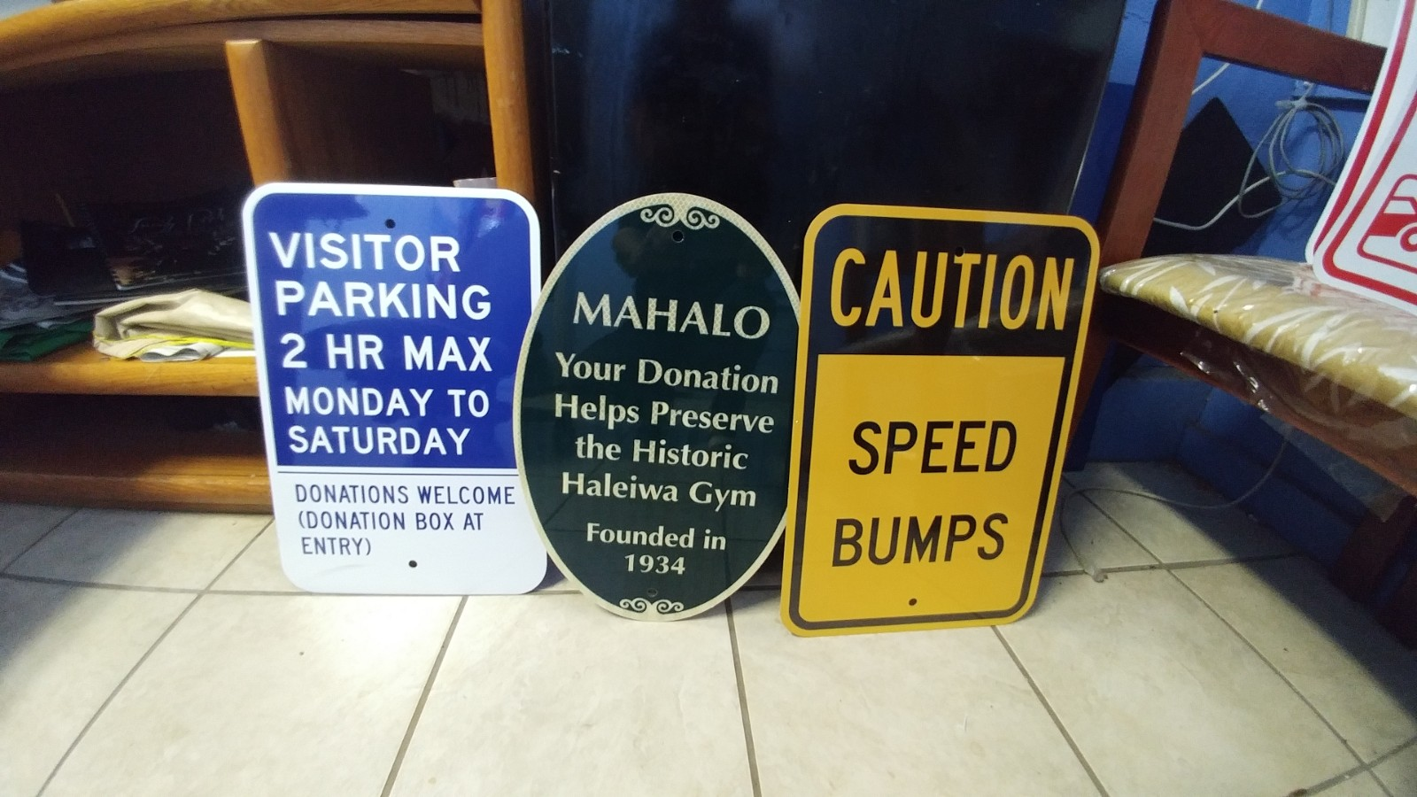
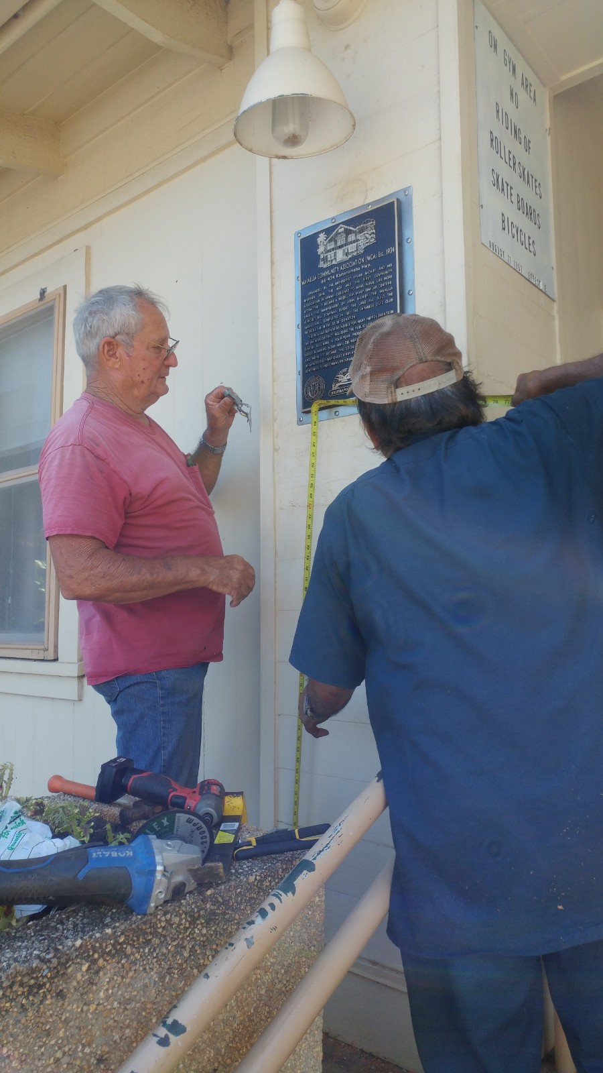
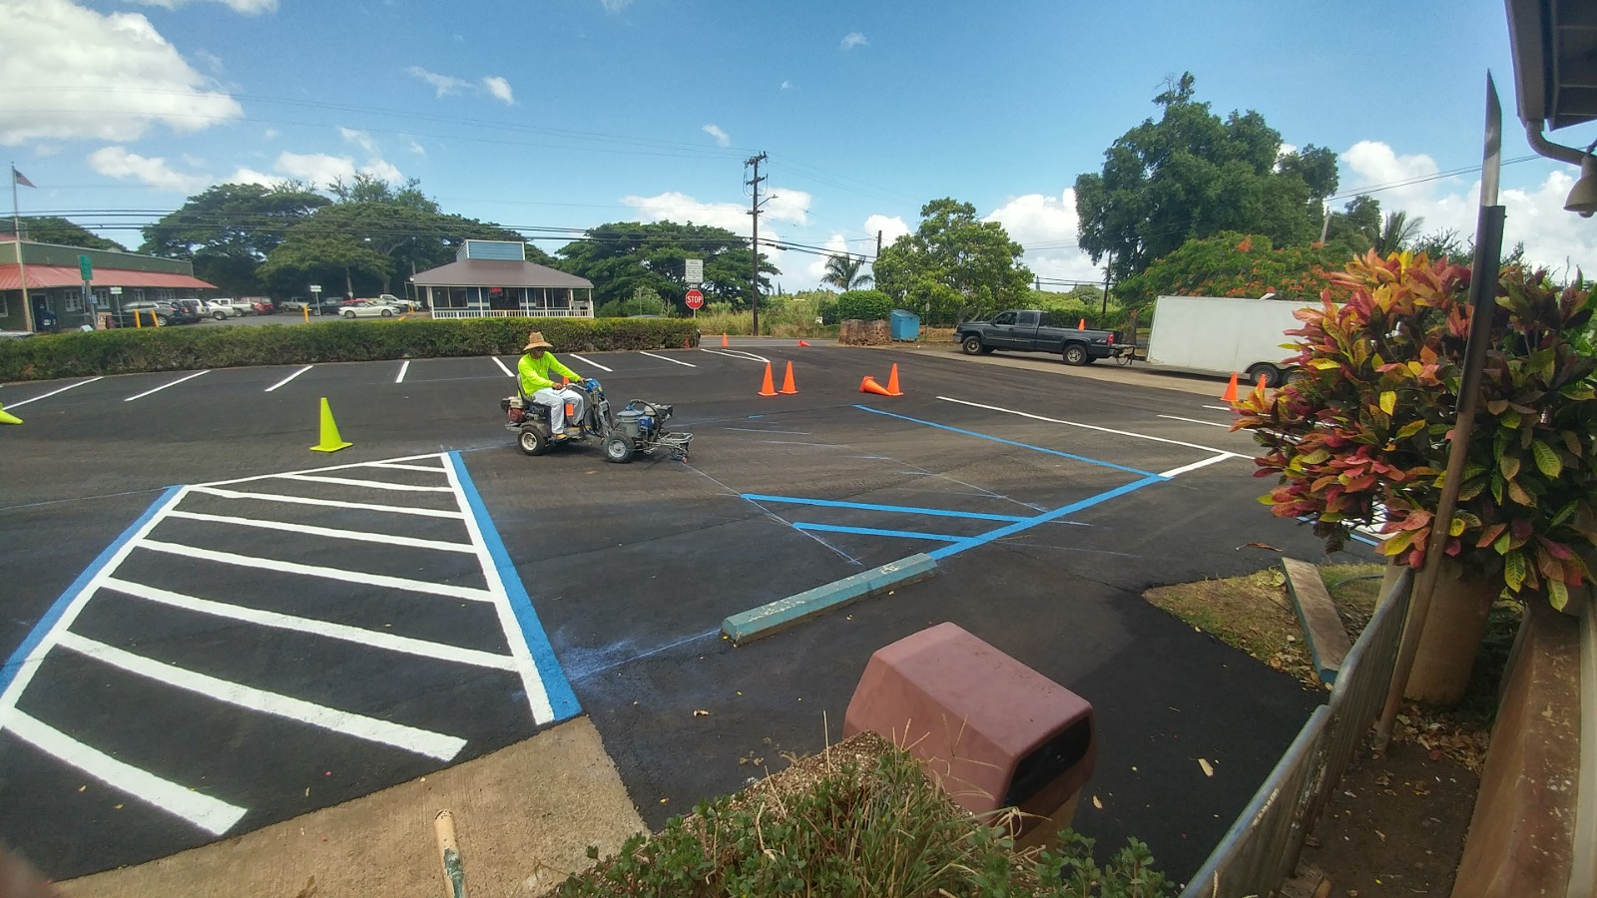
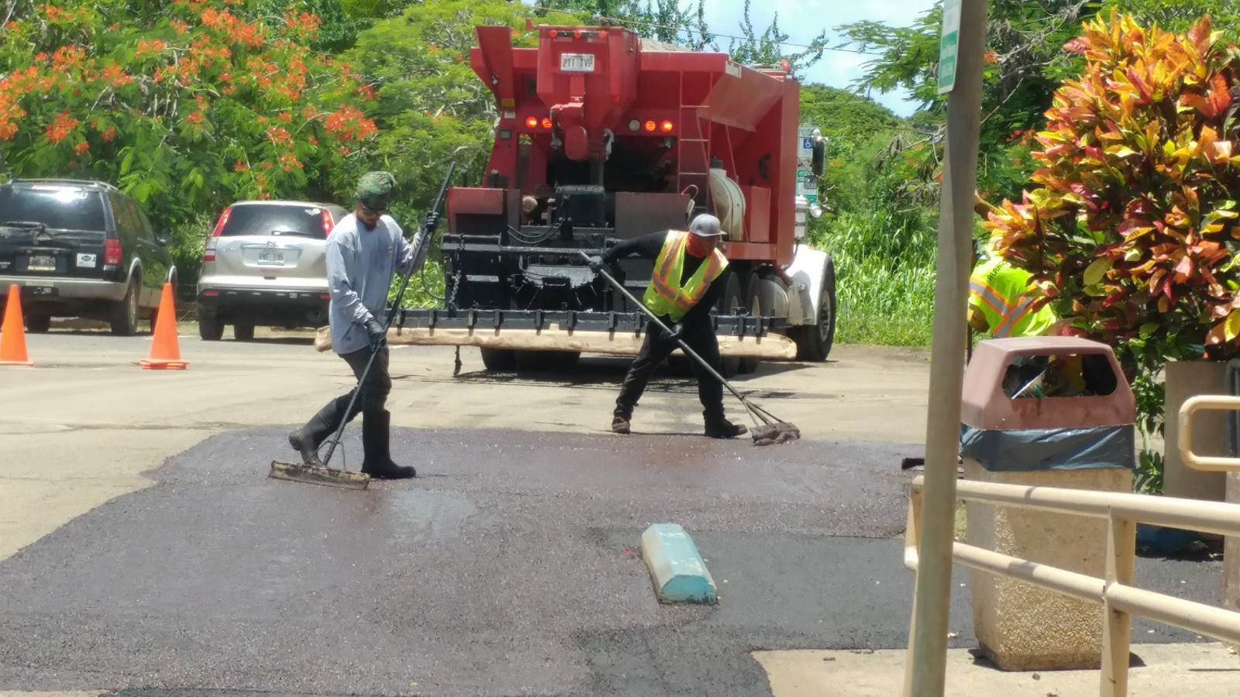
Work Accomplished

Slide 11
PARKING CHANGES
To better control our parking, the WCA will be implementing a parking management program which will:
Charge for parking at the WCA
Method and amount of fee will be determined
Members will receive a parking decal and get four hours free parking
No overnight parking will be allowed
Towing services have been initiated
Location, monthly fees and number of limited spaces for surrounding community business employees and Senior Center will be determined.

Slide 12
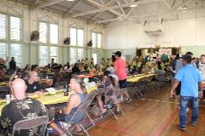
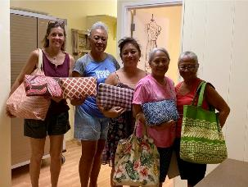
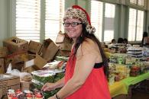
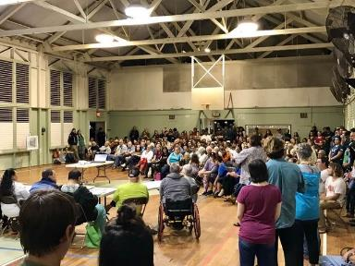
PROGRAM COMMITTEE
WCA SPONSORED:
ANNUAL THANKSGIVING DINNER
SEWING CLASSES
HALEIWA MARTIAL ARTS
I.H.S. AND PARTNERS
COMMUNITY MEETINGS
WCA EVENTS

Slide 13
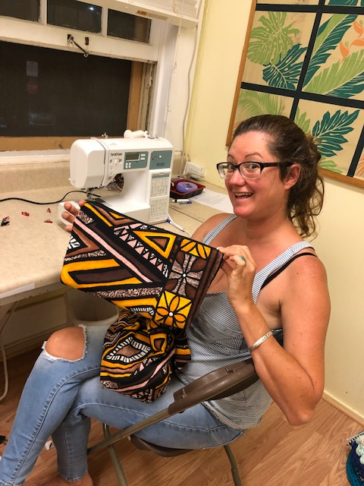
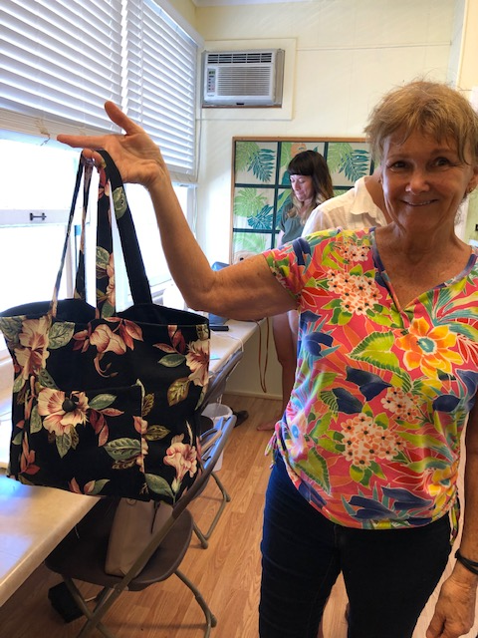
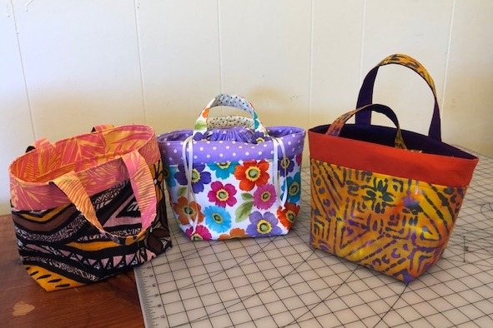
SEWING CLASSES WCA SPONSORED NONETTE UNGUREIT
Under the fine teaching of Nonette Ungureit, the WCA sponsored Sewing Class is in its fourth cycle. These women turn out some very beautiful products that they can finish within a single cycle of four weeks. Classes are held on Tuesdays and Wednesdays.

Slide 14
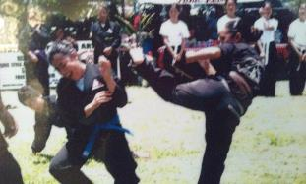
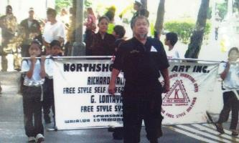
NORTH SHORE MARTIAL ARTS WCA SPONSORED RICHARD GALIUS
FREE STYLE KARATE
“Allow spirit, mind and body to adapt to the teaching of many styles of martial arts”
PHYSICAL FITNESS
DISCIPLINE
RESPECT
SELF DEFENSE

Slide 15
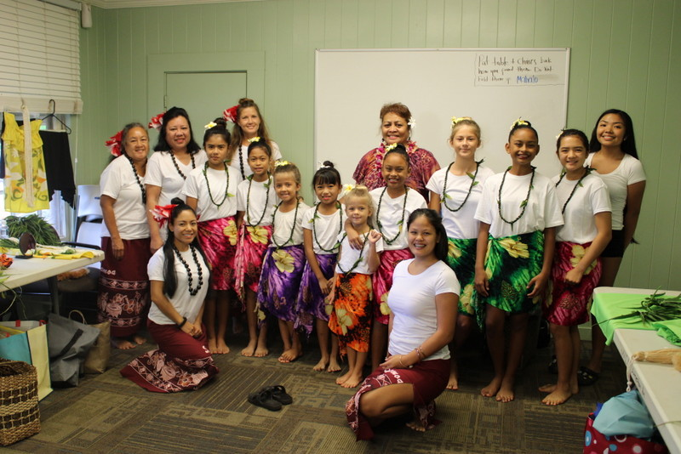
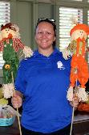
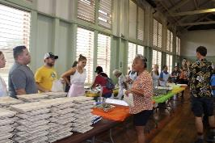
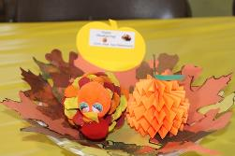
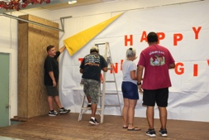
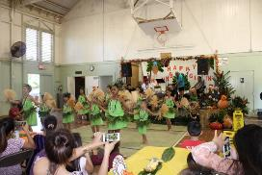
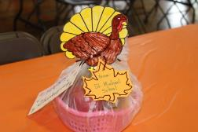
ANNUAL THANKSGIVING LUNCHEON
In Partnership with the North Shore News/North Shore Food Bank
With the help of many volunteers, the 2020 Annual Thanksgiving Dinner was a success feeding almost 200 needy community members.

Slide 16
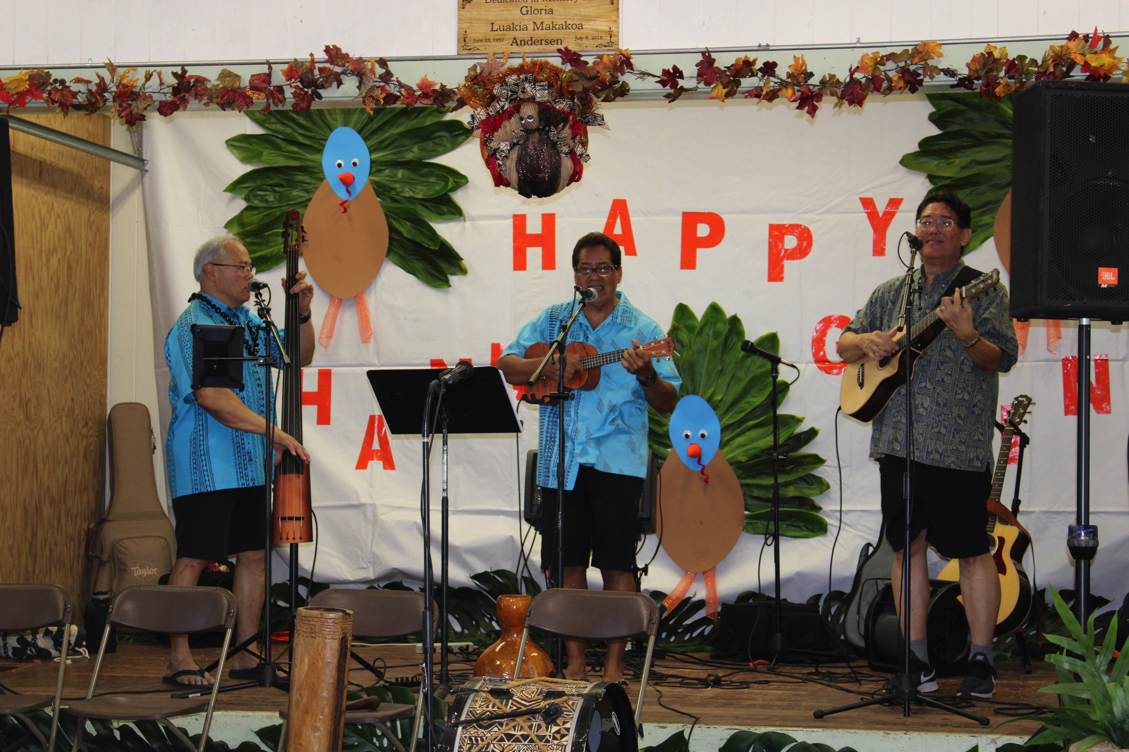
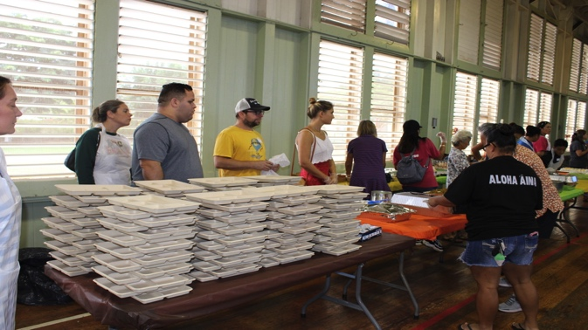
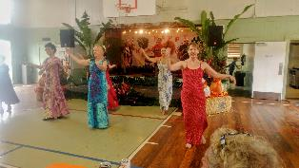
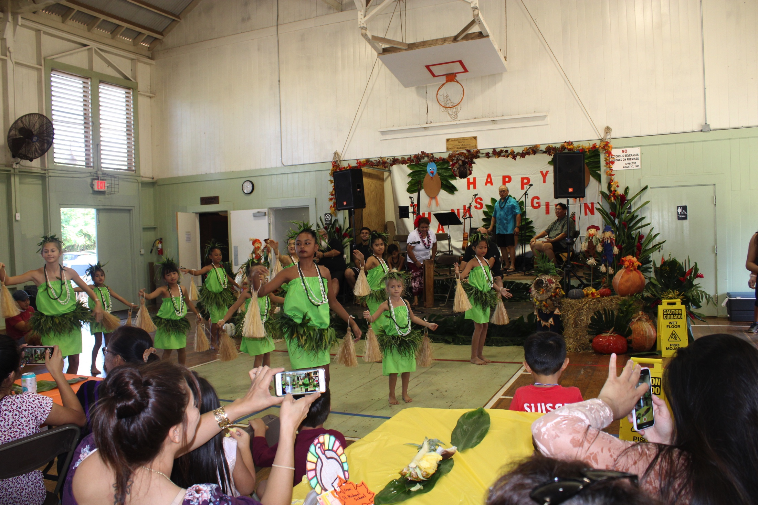
Annual Thanksgiving A Community Working Together…
Community Donors
Haleiwa Joe’s
Dole Pineapple
7-11 Stores
Ted’s Bakery
Waialua Bakery
Haleiwa Elem.
St. Michael’s
I.H.S.
Hawaii Food Bank
Alea Bridge
North Shore Christian Fellowship
Waimea Valley
Manu O Ke Kai Canoe Club
Frank and Leilani Perreira
Mohala Farms
WHIS Culinary – Marsha Taylor
Halau Kawaipuilani
Halau Makana a Ke Akua
Community Volunteers
To Make a Difference

Slide 17
I.H.S. COMMUNITY AND OUTREACH PARTNERS
INSTITUTE FOR HUMAN SERVICES
OTHER COMMUNITY PARTNERS
NORTH SHORE CHRISTIAN FELLOWSHIP
NORTH SHORE FOOD BANK
NORTH SHORE NEWS
NORTH SHORE CHAMBER OF COMMERCE
I.H.S. HOUSING I.H.S. EMPLOYMENT ALOHA HARVEST ALEA BRIDGE ECHY (DOE HOMELESS CONCERN LIASON) WAHIAWA HEALTH CENTER UNITED HEALTH CARE VETEREN’S AFFAIRS | PREMIER BENEFIT NORTH SHORE FOOD BANK OHANA FOOD DROP SENIOR BOXES CATHOLIC CHARITIES HOME PROJECT (MEDICAL MOBILE) CHILD AND FAMILY SERVICES HALEIWA JODO MISSION

Slide 18
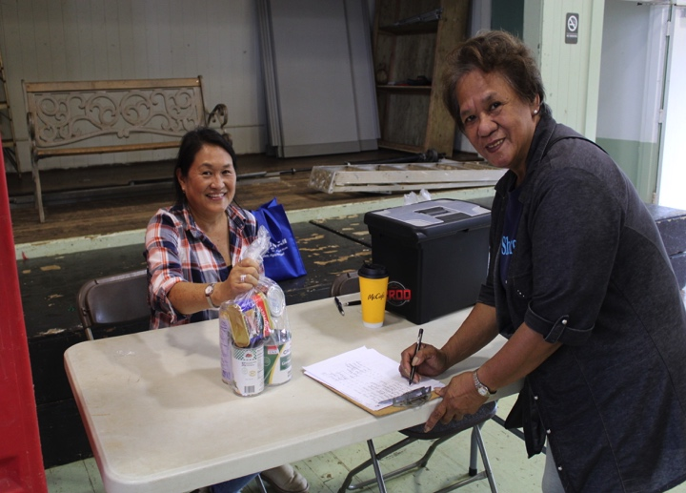
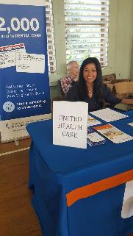
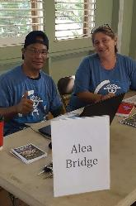
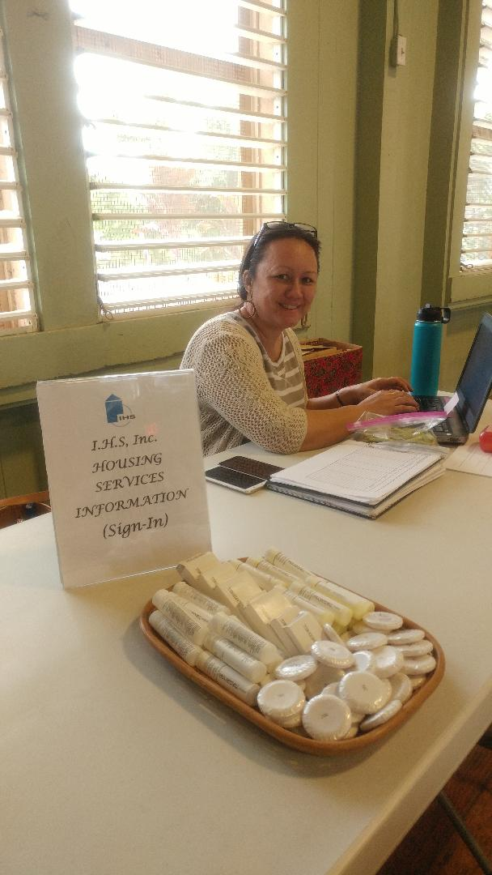
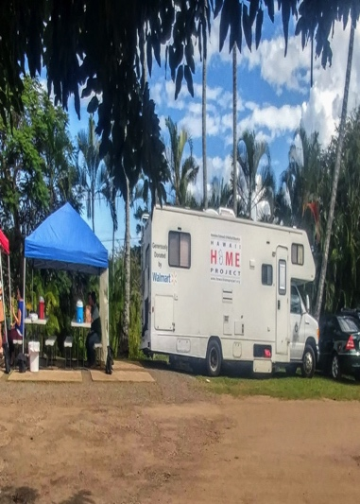
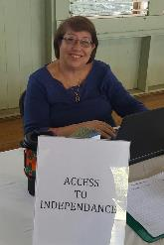
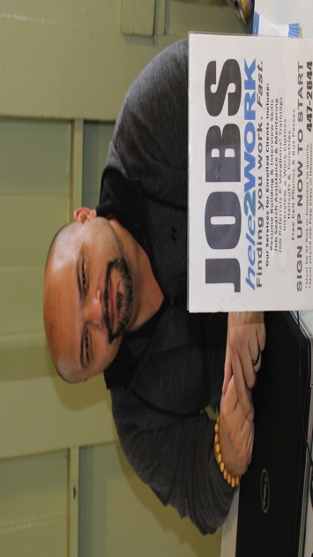
INSTITUTE FOR HUMAN SERVICES and COMMUNITY PARTNERS
North Shore Food Bank
Linda Seyler
Institute for Human Services
Heidi Apau
HOME Mobile
Health Unit

Slide 19
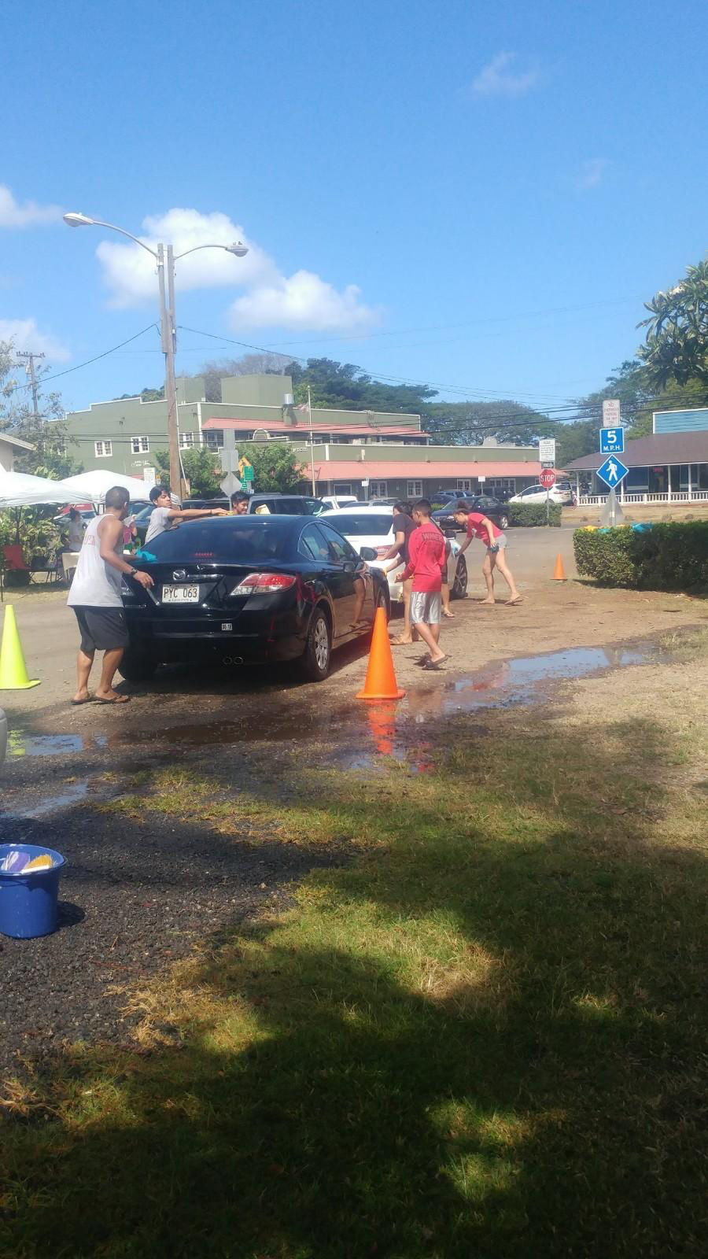
Activities at the WCA
I.H.S
Community Outreach
Food Bank
Car Wash
Lili’uokalani Trust
Senior Boxes

Slide 20
WCA Community Honorees Richard and Emma Galius

Slide 21
SHORT TERM LEASES
Halau Hula Makana A Ke Akua
Kalena’s Polynesian Ohana
Fitness By Coco
Halau Kawaipuilani
NSCF Dodge Ball

Slide 22
COMMERCIAL KITCHEN USERS
To better serve our Commercial Kitchen users, the WCA has been given a Grant in Aid to modify the kitchen. Mahalo to Sen. Gil Riviere and Rep. Sean Quinlin for their support. Work is expected to begin this year.
Carol’s Cook’n | Papiʻs Tacos
Soak and Smoke | Waialua Fast Foods
Nui’s Thai Food | Onolicious Grindz
Hono’s | Surfer’s Wife
Big Wave Cafe | Big Wave Shrimp
Kula Shave Ice | Onolicious Moments
Young’s Lunch Wagon | Poly’s Kitchen
Del-icious Burgers
SUPPORT OUR LOCAL VENDORS AND BUSINESSES!

Slide 23
LONG TERM LEASES
KA HANA PONO DAY CARE
LANDMARK BUILDERS
NORTH SHORE CHAMBER OF COMMERCE

Slide 24
GOALS FOR 2020
BUILDINGS & GROUNDS | OTHER
Upgrade Atherton Meeting Room | Increase Community Involvement
Install Fencing Where Needed | Offer Diversified Activities:
Paint Gym Interior Repair Gym Screens – Work ongoing | Start up Movie Night(s) to Include Cultural and Educational Films
Beautify Grounds | Sponsor Tutoring Classes
Complete Gym Floor Renovation Upgrade Commercial Kitchen | Create Competitive Games for Our Young People with Sponsorships
Improve Stage Area – Work Ongoing | Increase Membership
Upgrade Office – Work Ongoing | Mini-Museum Historical Display

Slide 25
LONG TERM GOALS
BUILDING & GROUNDS | OTHER
Replace Broken Jalousie Assemblies | Computer Lab Facilities
Split Air System for Offices/Atherton | Tutoring Program
Fire Sprinkler System | Get Member Participation
Paint Gym | Develop Sport Programs
Outdoor Pavilion | Ukulele Making
We can accomplish these goals as a community with your help

Slide 26
Volunteers make a Difference…

Slide 27
NEEDED REPAIRS…long overdue
If you want people to use the facility, it must look appealing. Our facilities need a “facelift”. We need volunteers and we need funding. Let’s make 2020 a year of achievements. With your help it can be done!

Slide 28
VISION OF THE FOUNDERS…
THAT THE PUPOSE OF THE ORGANIZATION WAS PURELY BENEVOLENT, CHARITABLE, EDUCATIONAL AND SCIENTIFIC DIRECTLY OR BY COOPERATION WITH OTHER AGENGIES WHICH INCLUDED:
A LIBRARY
BOY’S AND GIRL’S CLUBS
SPORT ACTIVITIES BOTH INSIDE AND OUTSIDE
GAMES
DRAMATICS
HOBBIES
ARTS AND CRAFTS
EDUCATIONAL CLASSES
CLINICS TO FURNISH MEDICAL ATTENDANCE FOR THE SICK AND DISABLED
MATERNAL AND INFANT CARE
WE HAVE THE FACILITIES BUT IT TAKES A COMMUNITY TO MAKE THIS HAPPEN. WHAT IS YOUR VISION?

Slide 29
LET US MOVE INTO THE FUTURE TOGETHER
1934…
2020

Slide 30
Dedication of Stage Plaque Honoring Gloria Luakia Makakoa Andersen

